Slide 1
실습 06
Design of Synchronous
Sequential Logics

Slide 2
Lab 6-1
The following is the specification for a logic designed during the class
The following is the timing illustration for the specification.
The circuit has one input and one output.
All changes in the circuit occur on the positive edge of a clock signal. (including the input)
The output is equal to 1 if during three or more preceding clock cycles the input was equal to 1. Otherwise, the output is 0.
Clock cycle:
t
t
t
t
t
t
t
t
t
t
t
0
1
2
3
4
5
6
7
8
9
10
w
:
0
1
1
0
1
1
1
1
1
0
1
z
:
0
0
0
0
0
0
0
1
1
1
0

Slide 3
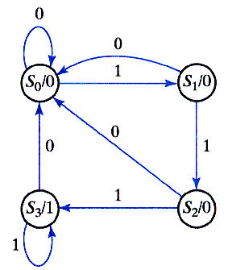
Lab 6-1 (continued)
The figure at the right is the
corresponding state diagram.
Design a synchronous sequential logic with gray coded states; that is to assign 00 to S0, 01 to S1, 11 to S2 and 10 to S3.
  Include all the details in the report.
  Compare the result with the one obtained in the class.
  Draw the logic with a BDF file in Quartus II.
  Simulate to verify whether the intended function is implemented. Capture the simulation result. Mark at each rising edge the input value and the output value.

Slide 4
Lab 6-2
The following is a modified specification of a logic designed in Lab 6-1.
The following is the timing illustration for the specification.
The circuit has one input and one output.
All changes in the circuit occur on the positive edge of a clock signal. (including the input)
The output is equal to 1 in the same clock when the consecutive three or more clock cycles the input was equal to 1. Otherwise, the output is 0.
Clock cycle:
t
t
t
t
t
t
t
t
t
t
t
0
1
2
3
4
5
6
7
8
9
10
w
:
0
1
1
0
1
1
1
1
1
0
1
z
:
0
0
0
0
0
0
1
1
1
0
0

Slide 5
Lab 6-2 (continued)
Design a synchronous sequential logic with a Mealy state machine.
  Include all the details in the report.
  Draw the logic with a BDF file in Quartus II.
  Simulate to verify the intended function is implemented. Capture the simulation result. Mark at each rising edge the input value and the output value.

